Slide 1
NH Forum on Broadband & Digital Equity
Exploring opportunities for collaboration & impact on intergenerational poverty
Friday September 22nd, 2023 10 am

Slide 2
Welcome and Introductions Matt Conserva, director of broadband initiatives, NH DBEA Chantal Virgile, National Community Impact Mgr., FCC

Slide 3
aims
1. Orient NH’s broadband providers and their partners to federal resources to assist your ACP outreach
BEAD funding for broadband access and digital equity
Digital equity capacity grant funding
FCC Affordable Connectivity Program Outreach grant – training several dozen digital navigators – to ideally triple or quadruple NH’s enrollment rate from 20%)
2. Alert you to the complementary supports being developed to work hand-in-glove with your efforts providing affordable broadband access (digital navigation, multilingual tech support, cybersafety & digital literacy skills development…)
3. Explore today how best to support your efforts to alert customers to ACP discount and your affordable pricing options for low-moderate income households

Slide 4
Brief orientation to BEAD funding

Slide 5
New Hampshire Broadband Equity, Access, & Deployment BEAD New Hampshire Department of Business and Economic Affairs (BEA) is the Administering Entity for the Broadband Equity, Access, and Deployment (BEAD) Program Grant. This grant is provided by the National Telecommunications and Information Administration (NTIA), U.S. Department of Commerce.

Slide 6
What does this mean for New Hampshire?
NH is allotted $196.56M when approved by NTIA
The BEAD funding will be used to deploy or upgrade broadband networks to ensure that everyone has access to reliable, affordable, high-speed Internet service.
Once deployment goals are met, any remaining funding can be used to pursue eligible access-, adoption-, and equity-related uses.

Slide 7
Project Scope of Work
Develop 5-Year Action Plan
Develop Initial Proposal
Volume I
Volume II
Develop Final Proposal
All documents will be posted for public comment; https://www.nheconomy.com/office-of-broadband-initiatives and we request your input.
You may also receive an e-mail as a reminder to review and comment on these documents. broadband@livefree.nh.gov.

Slide 8
About the Project
Statewide Public Survey
The Goal: To gather needs assessment data on five federally-established objectives for entire population, with a focus on the groups most affected by digital inequalities.
Questions are focused on gathering data on the digital equity needs and interests of individuals and households across the state.
Access The Survey: bit.ly/NHdigitalequitysurvey

Slide 9
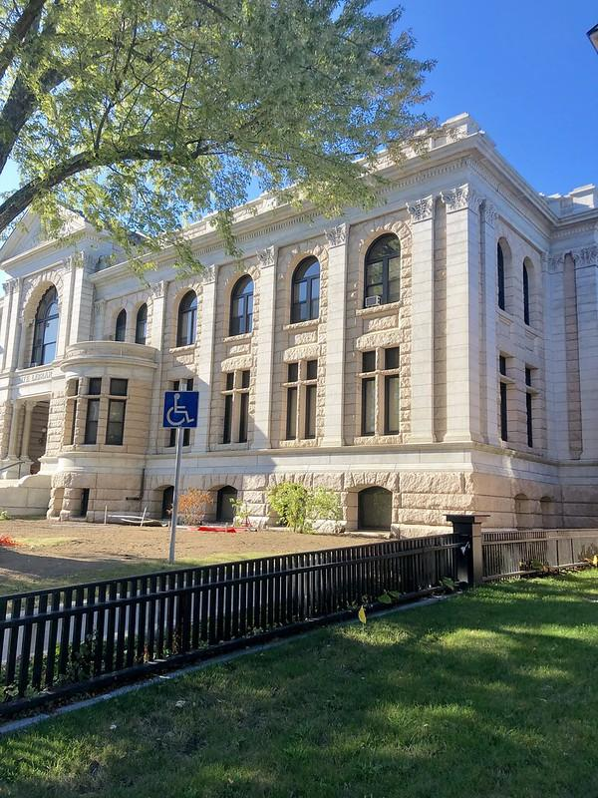
About the Project
Asset Inventory
The Goal: To document the community assets that exist across the state (i.e., public libraries, other community-based organizations, etc.)
Questions are focused on gathering data on how organizations support the five federally-established objectives for entire population, with a focus on the groups most affected by digital inequalities.
Get added to the Inventory: bit.ly/NHassetinventory
https://www.flickr.com/photos/warrenlemay/49211375371

Slide 10
Dimensions of digital equity the funding to NH can support
Affordable broadband
Free donor-funded refurbished and new laptops bundled with drive image pointing to systemic inclusion resources
Multilingual tech support provided by New Americans & other English Learners, for learners of all ages (Pre-K/parents through seniors)
Digital, media, information & financial literacy and cybersafety skill development and skills to use AI safely, effectively and ethically
More inclusive, accessible public websites pointing to essential inclusion supports (housing, legal, food, financial aid, job training, affordable broadband…)

Slide 11
Broadband provider contact info for ACP participation?
Bafflingly, ironically difficult to get contact info at providers for person who oversees ACP participation

Slide 12
How can we best support your efforts to alert your current & potential customers to the ACP discount? (what we’re learning from informal “survey”) Two dimensions of sustained media campaign: 1. Granite State News Collaborative coverage 2. Afterschool program youths using “solutions journalism” to provide sustained local coverage statewide of digital divide issues

Slide 13
How can we best publicize affordable pricing options for low/moderate income households?

Slide 14
Might you be interested in participating in sustained campaign to raise funding enabling you provide free refurbished/new laptops for ACP customers? * corporate giving programs * foundations * bank Community Reinvestment compliance programs * financial aid offices (if policy requires all students have a laptop) * workforce development programs * crucial to bundle tech support/digital navigator support with free device www.InclusionJunction.org www.cyberseniors.org

Slide 15
Any other insights and comments you’d like to share?

Slide 16
Next steps
Please kindly encourage folks to
Complete the digital equity survey
Briefly profile themselves in the Asset Inventory
Register for coming digital equity/BEAD planning events via www.NHdigitalequity.org
We’ll send you a copy of this side show and the webinar recording link

Slide 17
Thanks you very much!
www.NHdigitalequity.org
For more info:
Bob McLaughlin
Executive director
National Collaborative for Digital Equity
1.802.249.1159
https://calendly.com/rmclaughlin1

